Slide 1
Decision Trees

Slide 2
What is Decision Tree?
Decision Tree is a Supervised learning technique that can be used for both classification and Regression problems, but mostly it is preferred for solving Classification problems.
It is a tree-structured classifier, where internal nodes represent the features of a dataset, branches represent the decision rules and each leaf node represents the outcome.
In a Decision tree, there are two nodes, which are the Decision Node and Leaf Node.
Decision nodes are used to make any decision and have multiple branches, whereas Leaf nodes are the output of those decisions and do not contain any further branches.
The decisions or the test are performed on the basis of features of the given dataset.
It is a graphical representation for getting all the possible solutions to a problem/decision based on given conditions.

Slide 3
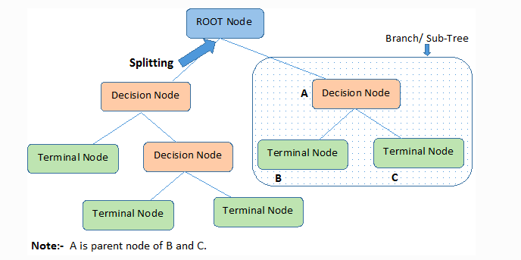
It is called a decision tree because, similar to a tree, it starts with the root node, which expands on further branches and constructs a tree-like structure.
In order to build a tree, we use the CART algorithm, which stands for Classification and Regression Tree algorithm.
A decision tree simply asks a question, and based on the answer (Yes/No), it further split the tree into subtrees.

Slide 4
Important Terminology related to Decision Trees
Root Node:
It represents the entire population or sample and this further gets divided into two or more homogeneous sets.
Splitting:
It is a process of dividing a node into two or more sub-nodes.
Decision Node:
When a sub-node splits into further sub-nodes, then it is called the decision node.
Leaf / Terminal Node:
Nodes do not split is called Leaf or Terminal node.
Pruning:
When we remove sub-nodes of a decision node, this process is called pruning. You can say the opposite process of splitting.
Branch / Sub-Tree:
A subsection of the entire tree is called branch or sub-tree.
Parent and Child Node:
A node, which is divided into sub-nodes is called a parent node of sub-nodes whereas sub-nodes are the child of a parent node.

Slide 5
Types of Decision Trees
Types of decision trees are based on the type of target variable we have. It can be of two types:
Categorical Variable Decision Tree: Decision Tree which has a categorical target variable then it called a Categorical variable decision tree.
Continuous Variable Decision Tree: Decision Tree has a continuous target variable then it is called Continuous Variable Decision Tree.

Slide 6
Let's illustrate this with help of an example.
Let's assume we want to play badminton on a particular day — say Saturday — how will you decide whether to play or not.
Let's say you go out and check if it's hot or cold, check the speed of the wind and humidity, how the weather is, i.e. is it sunny, cloudy, or rainy.
You take all these factors into account to decide if you want to play or not.
So, you calculate all these factors for the last ten days and form a lookup table like the one below.
Day | Weather | Temperature | Humidity | Wind | Play?
1 | Sunny | Hot | High | Weak | No
2 | Cloudy | Hot | High | Weak | Yes
3 | Sunny | Mild | Normal | Strong | Yes
4 | Cloudy | Mild | High | Strong | Yes
5 | Rainy | Mild | High | Strong | No
6 | Rainy | Cool | Normal | Strong | No
7 | Rainy | Mild | High | Weak | Yes
8 | Sunny | Hot | High | Strong | No
9 | Cloudy | Hot | Normal | Weak | Yes
10 | Rainy | Mild | High | Strong | No
Table 1. Observations of the last ten days.

Slide 7
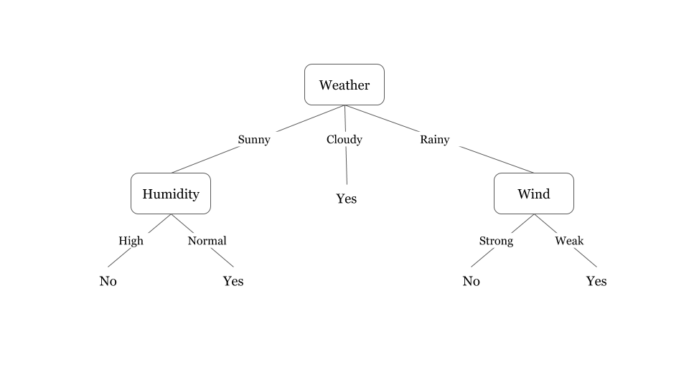
Now, you may use this table to decide whether to play or not.
But, what if the weather pattern on Saturday does not match with any of rows in the table? This may be a problem.
A decision tree would be a great way to represent data like this because it takes into account all the possible paths that can lead to the final decision by following a tree-like structure.

Slide 8
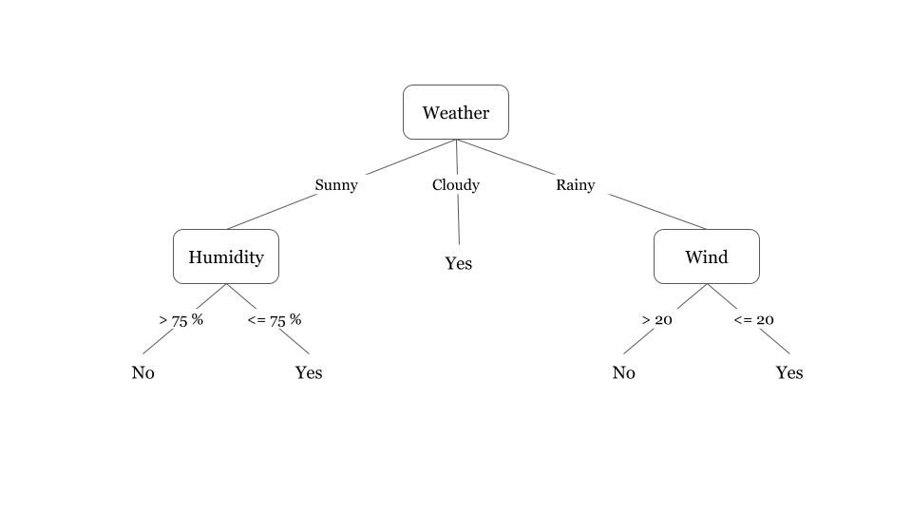
Fig 1. illustrates a learned decision tree.
We can see that each node represents an attribute or feature and the branch from each node represents the outcome of that node.
Finally, its the leaves of the tree where the final decision is made.
If features are continuous, internal nodes can test the value of a feature against a threshold

Slide 9
A general algorithm for a decision tree can be described as follows:
Pick the best attribute/feature. The best attribute is one which best splits or separates the data.
Ask the relevant question.
Follow the answer path.
Go to step 1 until you arrive to the answer.
The best split is one which separates two different labels into two sets.

Slide 10
How does the Decision Tree algorithm Work?
In a decision tree, for predicting the class of the given dataset, the algorithm starts from the root node of the tree.
This algorithm compares the values of root attribute with the record (real dataset) attribute and, based on the comparison, follows the branch and jumps to the next node.
For the next node, the algorithm again compares the attribute value with the other sub-nodes and move further.
It continues the process until it reaches the leaf node of the tree.

Slide 11
The complete process can be better understood using the below algorithm:
Step-1: Begin the tree with the root node, says S, which contains the complete dataset.
Step-2: Find the best attribute in the dataset using Attribute Selection Measure (ASM).
Step-3: Divide the S into subsets that contains possible values for the best attributes.
Step-4: Generate the decision tree node, which contains the best attribute.
Step-5: Recursively make new decision trees using the subsets of the dataset created in step -3. Continue this process until a stage is reached where you cannot further classify the nodes and called the final node as a leaf node.

Slide 12
Attribute Selection Measures
If the dataset consists of N attributes then deciding which attribute to place at the root or at different levels of the tree as internal nodes is a complicated step.
By just randomly selecting any node to be the root can’t solve the issue.
If we follow a random approach, it may give us bad results with low accuracy.
There are two popular techniques for ASM, which are:
Information Gain
Gini Index

Slide 13
Advantages of Decision Tree
Simple to understand and to interpret. Trees can be visualized.
Requires little data preparation. Other techniques often require data normalization, dummy variables need to be created and blank values to be removed. Note however that this module does not support missing values.
The cost of using the tree (i.e., predicting data) is logarithmic in the number of data points used to train the tree.
Able to handle both numerical and categorical data. However scikit-learn implementation does not support categorical variables for now. Other techniques are usually specialized in analyzing datasets that have only one type of variable.

Slide 14
Able to handle multi-output problems.
Uses a white box model. If a given situation is observable in a model, the explanation for the condition is easily explained by Boolean logic. By contrast, in a black box model (e.g., in an artificial neural network), results may be more difficult to interpret.
Possible to validate a model using statistical tests. That makes it possible to account for the reliability of the model.
Performs well even if its assumptions are somewhat violated by the true model from which the data were generated.

Slide 15
Disadvantages of Decision Trees
Decision-tree learners can create over-complex trees that do not generalize the data well. This is called overfitting.
Mechanisms such as pruning, setting the minimum number of samples required at a leaf node or setting the maximum depth of the tree are necessary to avoid this problem.
Decision trees can be unstable because small variations in the data might result in a completely different tree being generated. This problem is mitigated by using decision trees within an ensemble.
Predictions of decision trees are neither smooth nor continuous, but piecewise constant approximations as seen in the above figure. Therefore, they are not good at extrapolation.

Slide 16
The problem of learning an optimal decision tree is known to be NP-complete under several aspects of optimality and even for simple concepts.
Consequently, practical decision-tree learning algorithms are based on heuristic algorithms such as the greedy algorithm where locally optimal decisions are made at each node.
Such algorithms cannot guarantee to return the globally optimal decision tree. This can be mitigated by training multiple trees in an ensemble learner, where the features and samples are randomly sampled with replacement.
There are concepts that are hard to learn because decision trees do not express them easily, such as XOR, parity or multiplexer problems.
Decision tree learners create biased trees if some classes dominate. It is therefore recommended to balance the dataset prior to fitting with the decision tree.

